Slide 1

Space X Falcon 9
Scientist Analyzing
M Sadewa Wicaksana W
11 July 2024
https://github.com/sadewa25/ibm-datascience

Slide 2
Outline
Executive Summary
Introduction
Methodology
Results
Conclusion

Slide 3
Executive Summary
Summary of methodologies
Data Collection SpaceX API
Data Collection with Web Scraping
Data Wrangling
Data Exploratory Data Analysis
EDA DataViz
Summary of all results
EDA Results
Interactive Visual Analytics and Dashboards

Slide 4

Introduction
SpaceX advertises Falcon 9 rocket launches on its website with a cost of 62 million dollars; other providers cost upward of 165 million dollars each, much of the savings is because SpaceX can reuse the first stage. Therefore if we can determine if the first stage will land, we can determine the cost of a launch. This information can be used if an alternate company wants to bid against SpaceX for a rocket launch

Slide 5
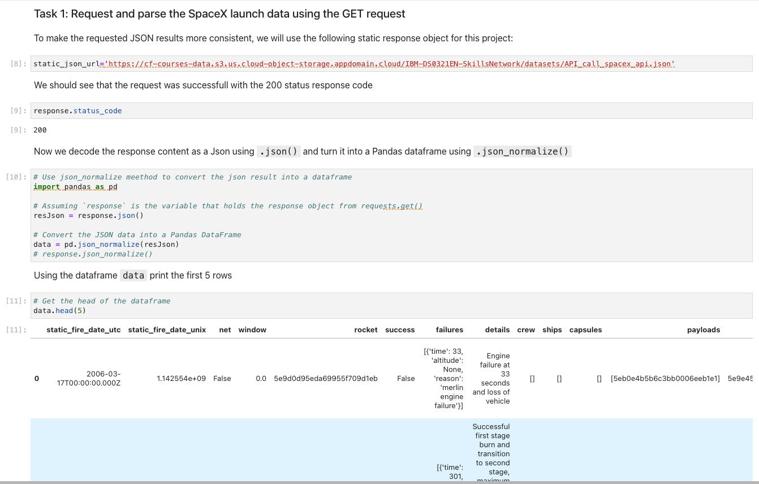
Data Collection
Data collected from public website starlink space X Falcon 9. To get the data clear without noise data is normalize using json_normalize()

Slide 6
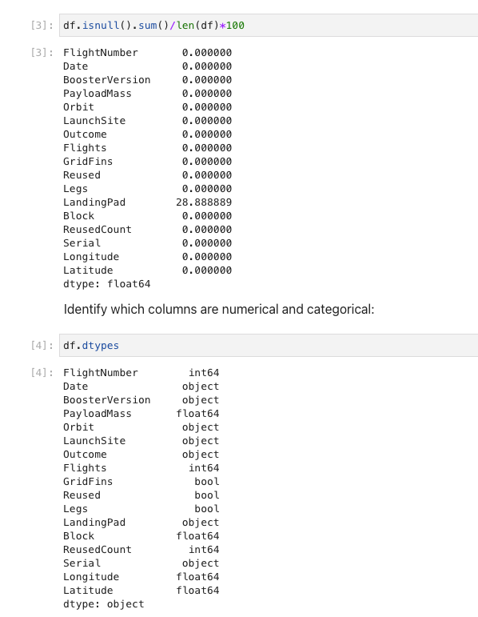
Data Wrangling
With data wrangling, exploratory data is started with check available nullable data and check data type in each columns.

Slide 7
EDA with Data Visualization
Performed data Analysis and Feature Engineering using Pandas and Matplotlib i.e Exploratory Data Analysis and Preparing Data Feature Engineering
Used scatter plots to Visualize the relationship between Flight Number and Launch Site, Payload and Launch Site, FlightNumber and Orbit type, Payload and Orbit type.
Used Bar chart to Visualize the relationship between success rate of each orbit type
Line plot to Visualize the launch success yearly trend

Slide 8
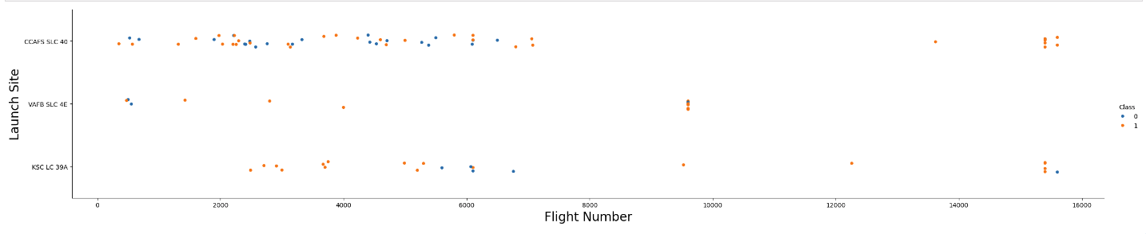
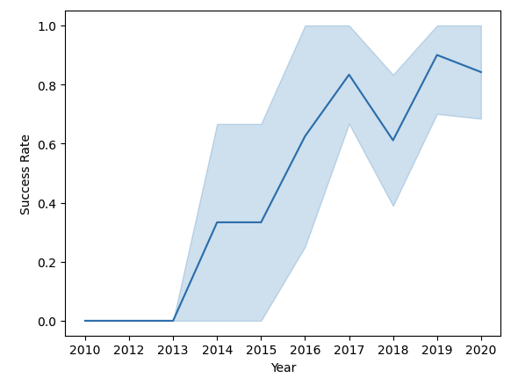
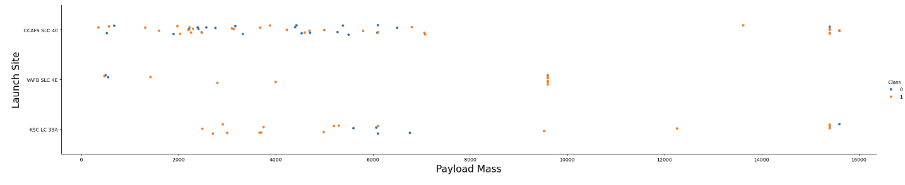
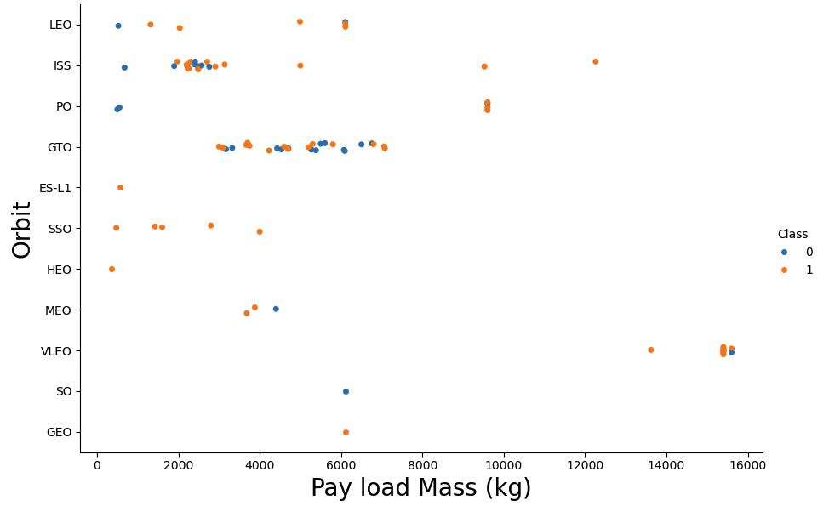
EDA with Data Visualization (Contd..)

Slide 9
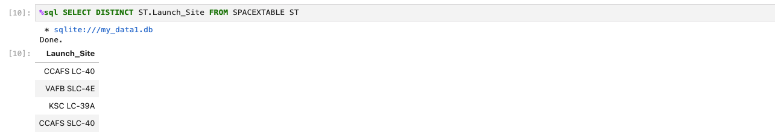

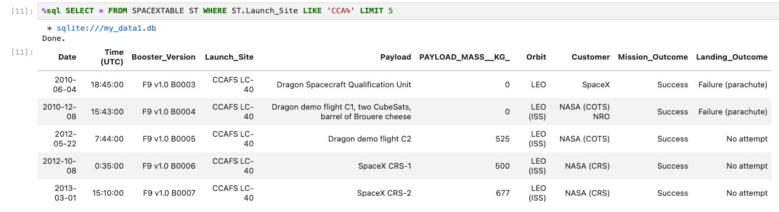
EDA with SQL
Display the names of unique launch sites
Display 5 records begin with string CCA

Slide 10
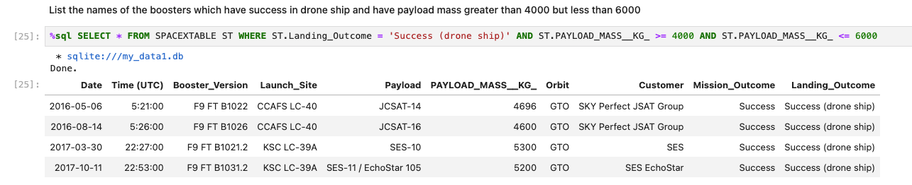
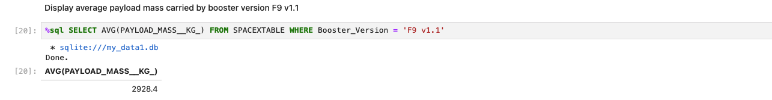
EDA With SQL (Contd..)
List names of the boosters with payload mass greater than 4000 and less than 6000
Display average payload mass with carried by booster version F9 v1.1

Slide 11
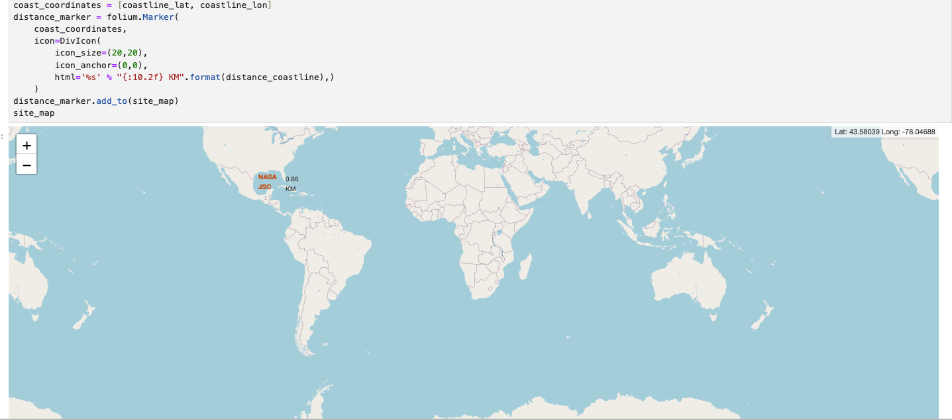
Build an interactive map with folium
Calculate Distance between the coastline point and the launch site

Slide 12
Build a Dashboard with Plotly Dash
Built an interactive dashboard application with Plotly dash by:
a. Adding a Launch Site Drop-down Input Component
b. Adding a callback function to render success-pie-chart based on selected site
dropdown
c. Adding a Range Slider to Select Payload
d. Adding a callback function to render the success-payload-scatter-chart scatter plot

Slide 13
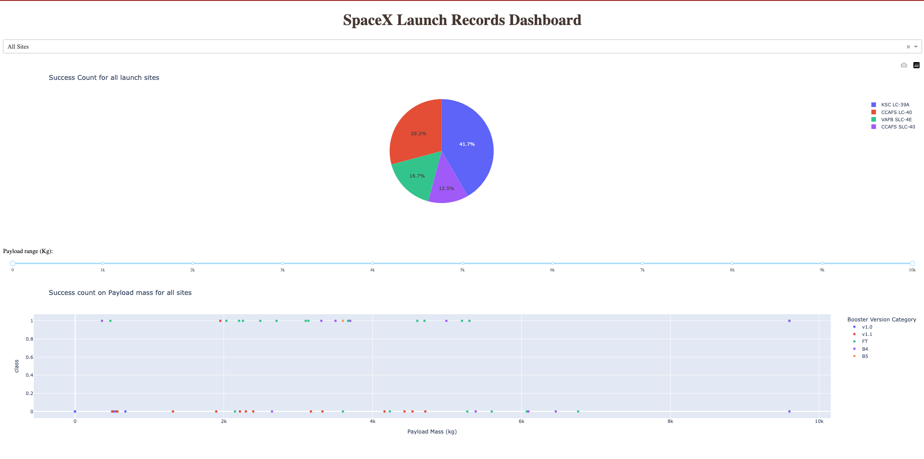
SpaceX Dash App

Slide 14
Predictive Analysis
In order to find the best ML model/ method that would performs best using the test data between SVM, Classification Trees, k nearest neighbors and Logistic Regression;
First created an object for each of the algorithms then created a GridSearchCV object and assigned them a set of parameters for each model.
For each of the models under evaluation, the GridsearchCV object was created with cv=10, then fit the training data into the GridSearch object for each to Find best Hyperparameter.
After fitting the training set, we output GridSearchCV object for each of the models, then displayed the best parameters using the data attribute best_params_ and the accuracy on the validation data using the data attribute best_score_.
Finally using the method score to calculate the accuracy on the test data for each model and plotted a confussion matrix for each using the test and predicted outcomes.

Slide 15
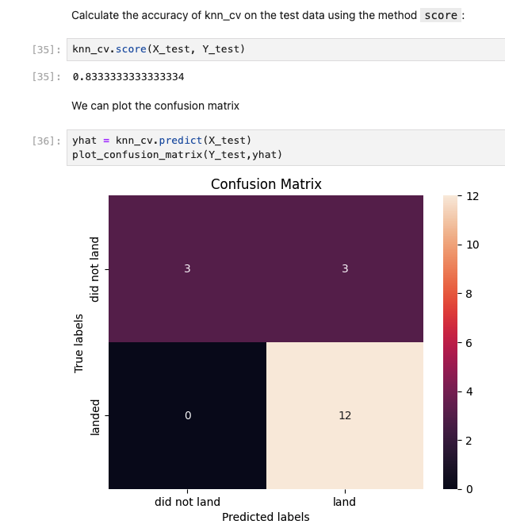
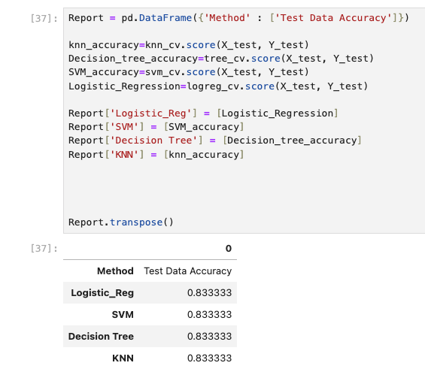
Summary
The table below shows the test data accuracy score for each of the methods comparing them to show which performed best using the test data between SVM, Classification Trees, k nearest neighbors and Logistic Regression;

Slide 16
Thanks

